Slide 1
Statistical and Machine Learning Methods to Forecast and Predict Conflict with ACLED Data
CENTER FOR DIGITAL ACCELERATION
May 6th, 2022

Slide 2
ACLED
Background: Advances in data accessibility and computing power has brought lots of promise to conflict prediction. For our specific projects, policymakers can take actions to prevent local conflict before it begins, if it can be accurately predicted.
The ACLED dataset provides event-specific location data for 180 countries. These conflict events contain important information surrounding the type of conflict, the actors involved, number of fatalities (if any), and time and location.
Objective: Review past evidence on the feasibility of conflict prediction and present case study predicting conflict at the subnational level in Colombia using ACLED data and auxiliary data.
Notes:
We wanted to know where conflict was taking place in Ukraine and who the top actors were for those events
So – we built a dashboard using the ACLED dataset to understand where the fatalities and civilian based conflict was occurring, who the key players were and how these events trended over time
So we can look at where the events are taking place
Who was attributable for those events (give example of Russian forces)
Who these actors were interacting with in these events for example NAF was primarily interacting with the Donbass People’s Military, Luhansk and Civilians
How frequently these events were happening
What types of events were taking place – here we can see an greater portion of the events are Explosions/remote violence and battles
Event conflict data helps us analyze events by the type of event, the actors involved in the event or who is accountable, where the event took place and when the event happened and how the frequency of events or trends might have evolved over time.

Slide 3
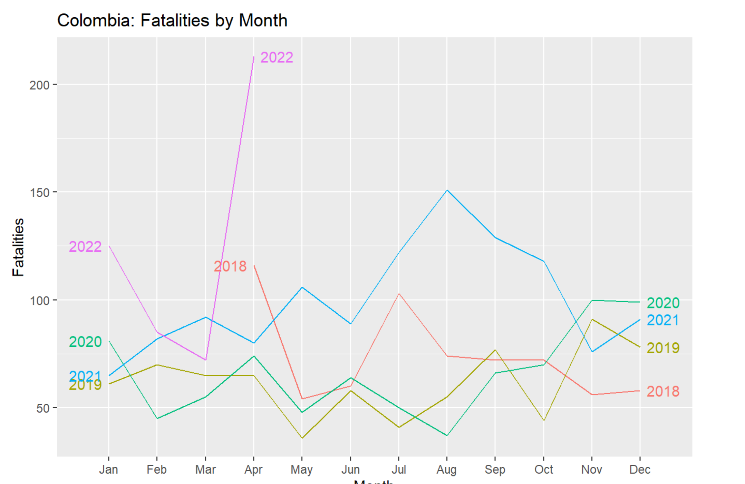
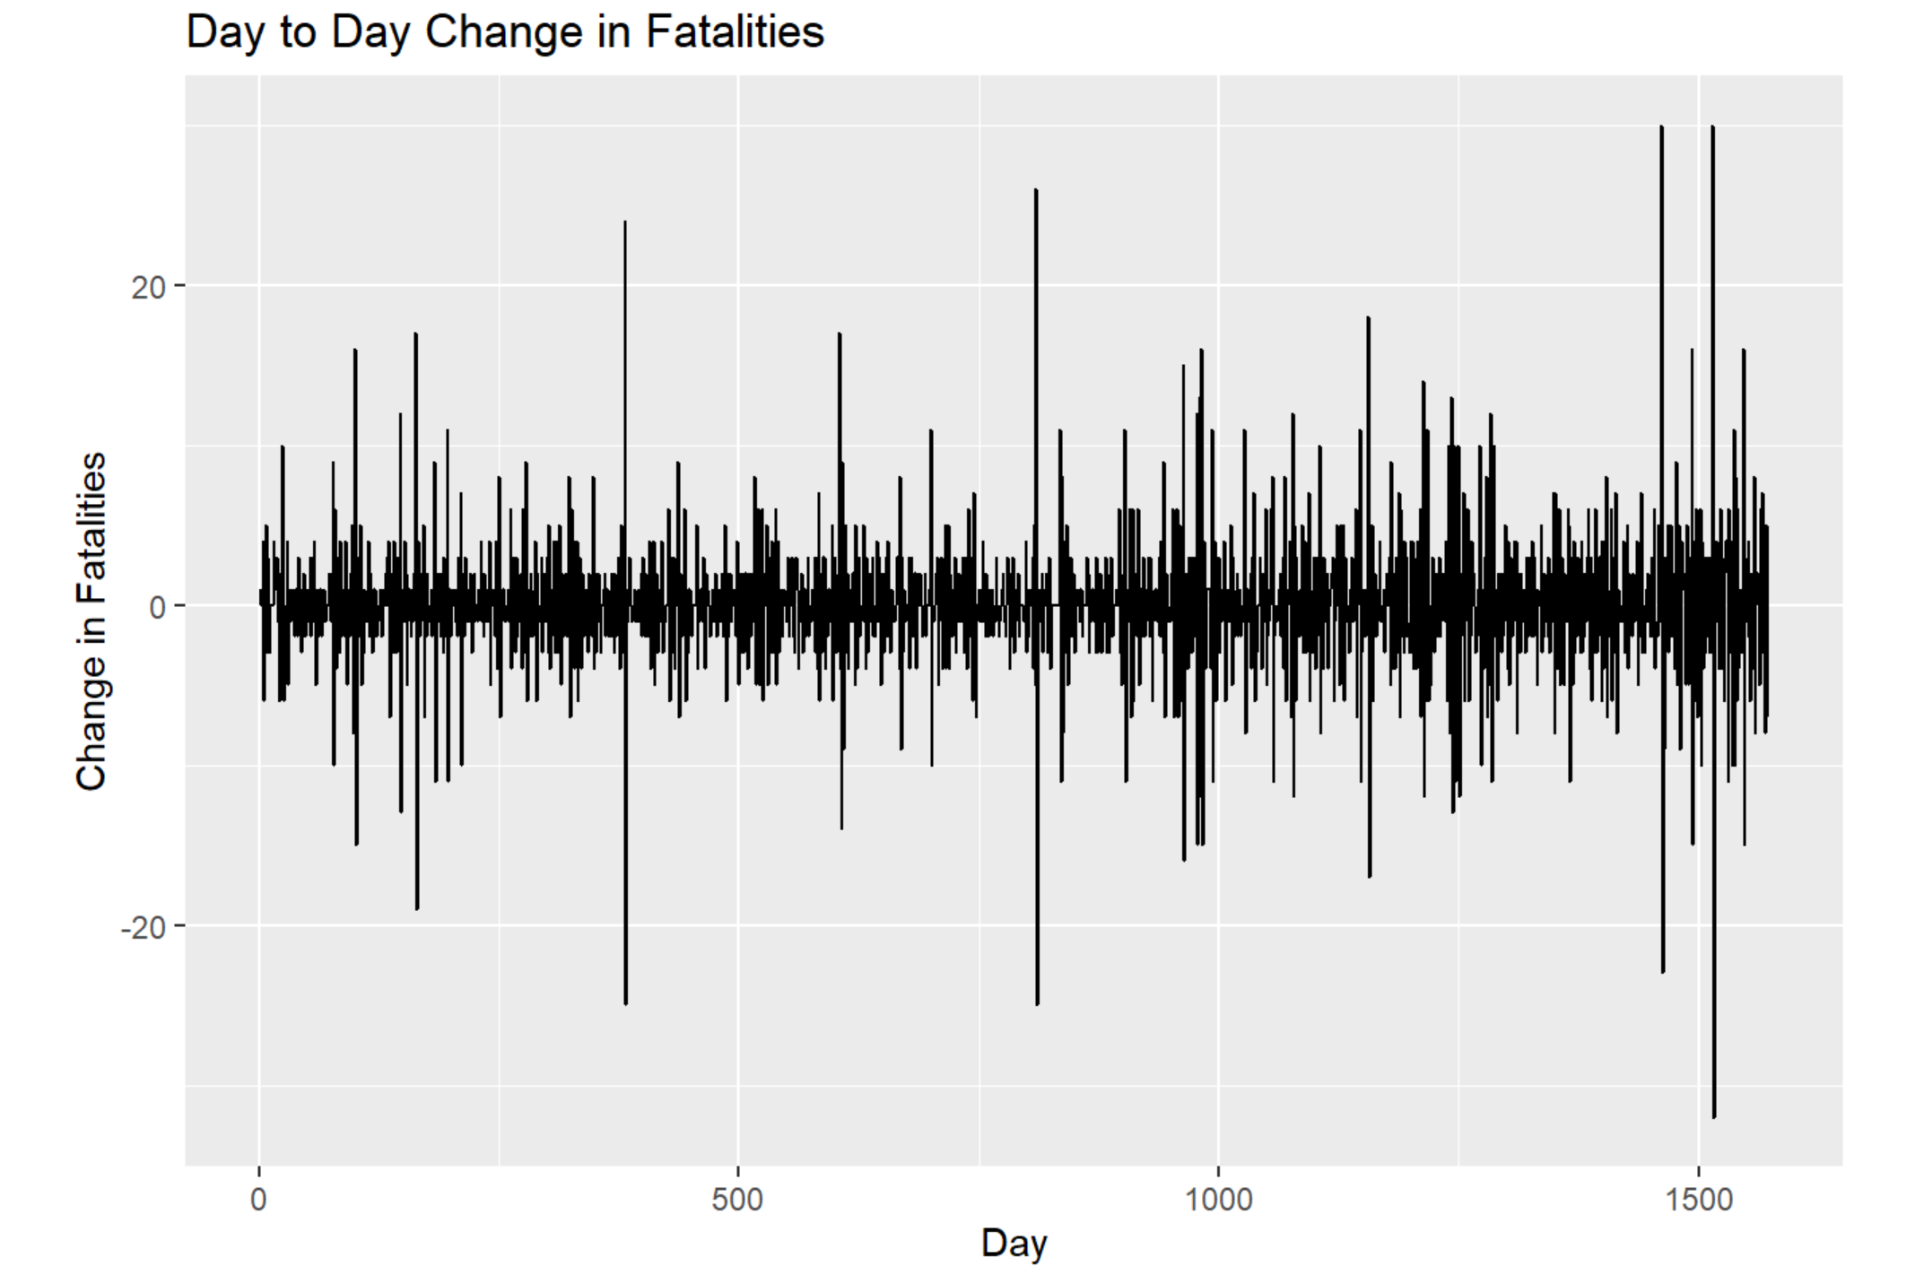
ACLED
Challenges to Conflict Prediction and Forecasting:
Difficult to find time-variant auxiliary data to match to conflict event data.
Much more difficult to find time-variant auxiliary data at the subnational or more granular levels to match conflict events.
Some evidence suggests these variables can worsen predictive accuracy.
Conflict does not frequently occur.
Conflict is not auto-regressive (future conflict does not depends on where past conflict occurred).

Slide 4
ACLED
What does the evidence suggest?
Conflict in the next year is predictable using time-invariant auxiliary data (Bazzi et al. 2019).
Location-based hot spot prediction provides accurate results using time-invariant auxiliary data and geospatial covariates (Blair, Hartman & Blattman 2016).
Mixed evidence on the feasibility of monthly conflict prediction (Beger, Dorff, & Ward, 2014).
Time variant variables, such as natural disasters, commodity prices, do a particularly poor job of predicting conflict.
Early warning systems may not be feasible:
Month or day level forecasting has limited predictive power.
Challenging to predict new outbreaks or escalations of violence. (Bazzi et al 2019).
Literature Review

Slide 5
ACLED
Key variables used for prediction:
Electoral: probability ratio index, first round vote for Colombia Humana party (Petro); first round vote for Centro Democratico (Duque); electoral margin for Presidential vote in second round run-off.
Demographic: diversity index, percent ethnic minority, total population, population density (DANE 2018 Census).
Socioeconomic: NBI poverty rate; GDP per capita; percent in estrato one; percent of ‘ni-ni’s’; percent of young males completed primary school and above (DANE 2018 Census & ECV 2020).
Geospatial: terrain ruggedness index (TRI); nightlights (NL); distance to a city of 50K inhabitants; vegetation index (NDVI);
Public Finances: fiscal transfer dependence; primary municipal deficit; current account deficit (Ministry of Planning 2020).
Natural Disasters: natural disasters event data (Min. Environment - 2018-2021)
Case Study: Predicting Conflict in Colombia.
Timeframe – 04/01/2018 – Present.
Notes:
We wanted to know where conflict was taking place in Ukraine and who the top actors were for those events
So – we built a dashboard using the ACLED dataset to understand where the fatalities and civilian based conflict was occurring, who the key players were and how these events trended over time
So we can look at where the events are taking place
Who was attributable for those events (give example of Russian forces)
Who these actors were interacting with in these events for example NAF was primarily interacting with the Donbass People’s Military, Luhansk and Civilians
How frequently these events were happening
What types of events were taking place – here we can see an greater portion of the events are Explosions/remote violence and battles
Event conflict data helps us analyze events by the type of event, the actors involved in the event or who is accountable, where the event took place and when the event happened and how the frequency of events or trends might have evolved over time.

Slide 6
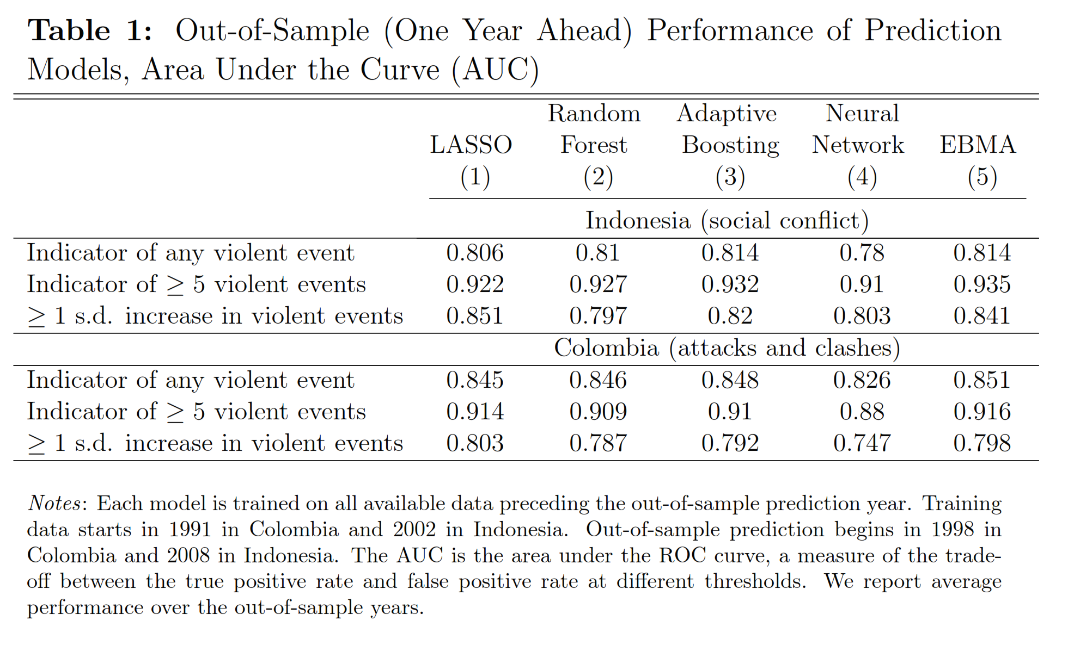
ACLED
Methodology:
Following similar method used in Bazzi et al 2019:
Partition data into test and training datasets.
Training dataset contains conflict and auxiliary data for 2018-2020.
Train LASSO, Random Forest, Gradient Boosting Machine – Xboost, and Support Vector Machine maching learning algorithms on training dataset for 2018-2020.
Based on results, predict the likelihood of one violent event, five violent events, and a one-year standard deviation increase in violent events for 2021.
Report on key accuracy metrics: AUC/ROC, Accuracy, Specificity, Sensitivity.
Case Study: Predicting Conflict in Colombia.
Timeframe – 04/01/2018 – Present.
Notes:
We wanted to know where conflict was taking place in Ukraine and who the top actors were for those events
So – we built a dashboard using the ACLED dataset to understand where the fatalities and civilian based conflict was occurring, who the key players were and how these events trended over time
So we can look at where the events are taking place
Who was attributable for those events (give example of Russian forces)
Who these actors were interacting with in these events for example NAF was primarily interacting with the Donbass People’s Military, Luhansk and Civilians
How frequently these events were happening
What types of events were taking place – here we can see an greater portion of the events are Explosions/remote violence and battles
Event conflict data helps us analyze events by the type of event, the actors involved in the event or who is accountable, where the event took place and when the event happened and how the frequency of events or trends might have evolved over time.

Slide 7
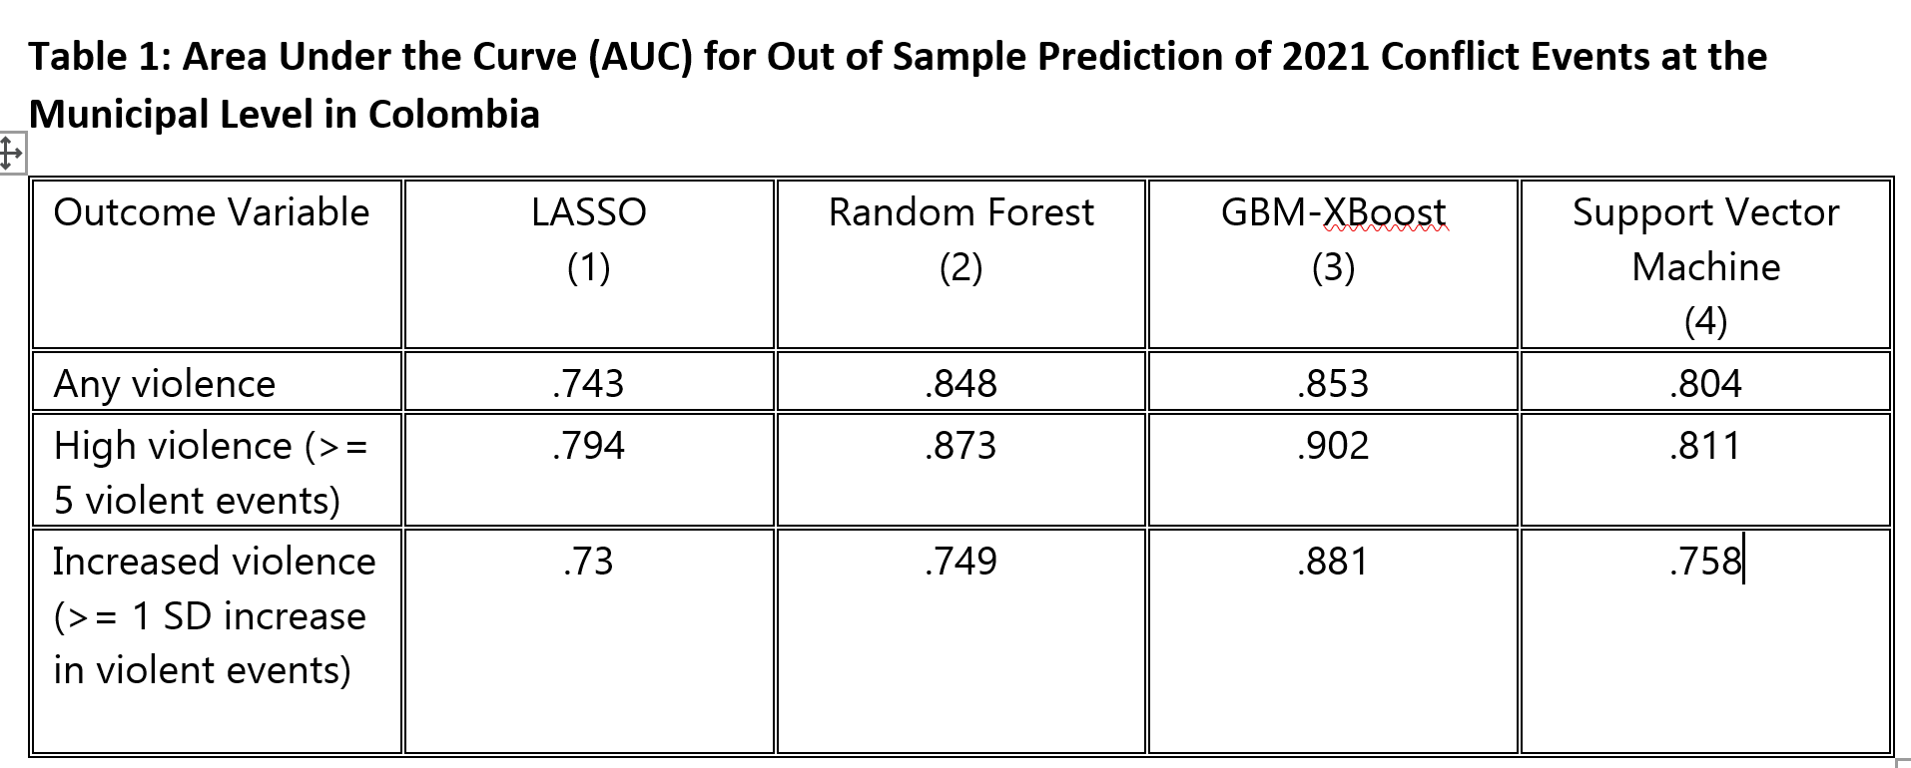
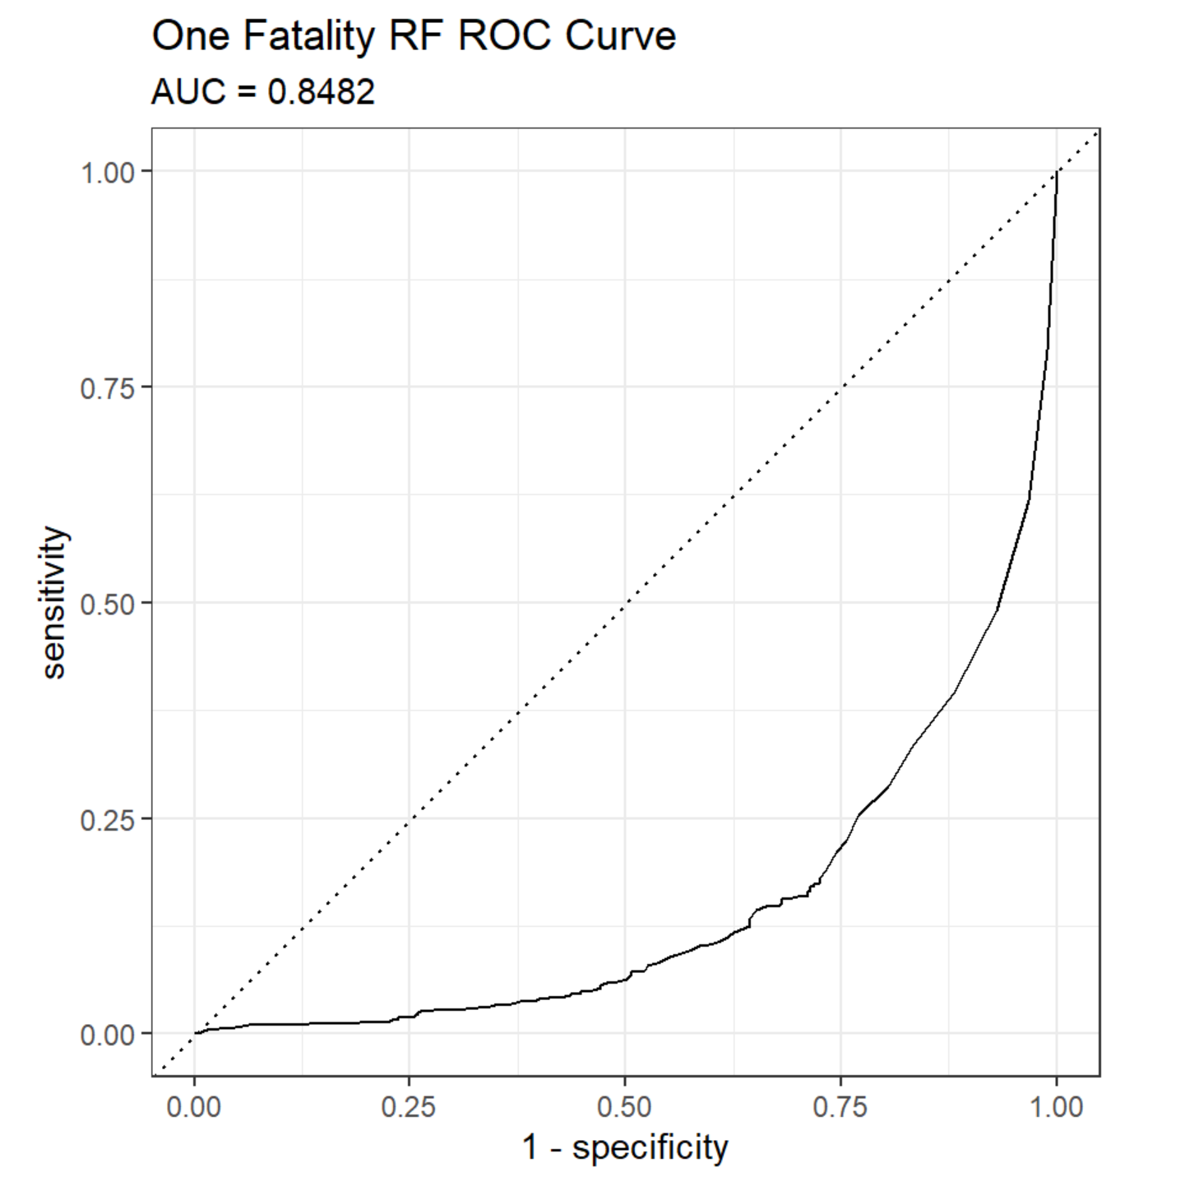
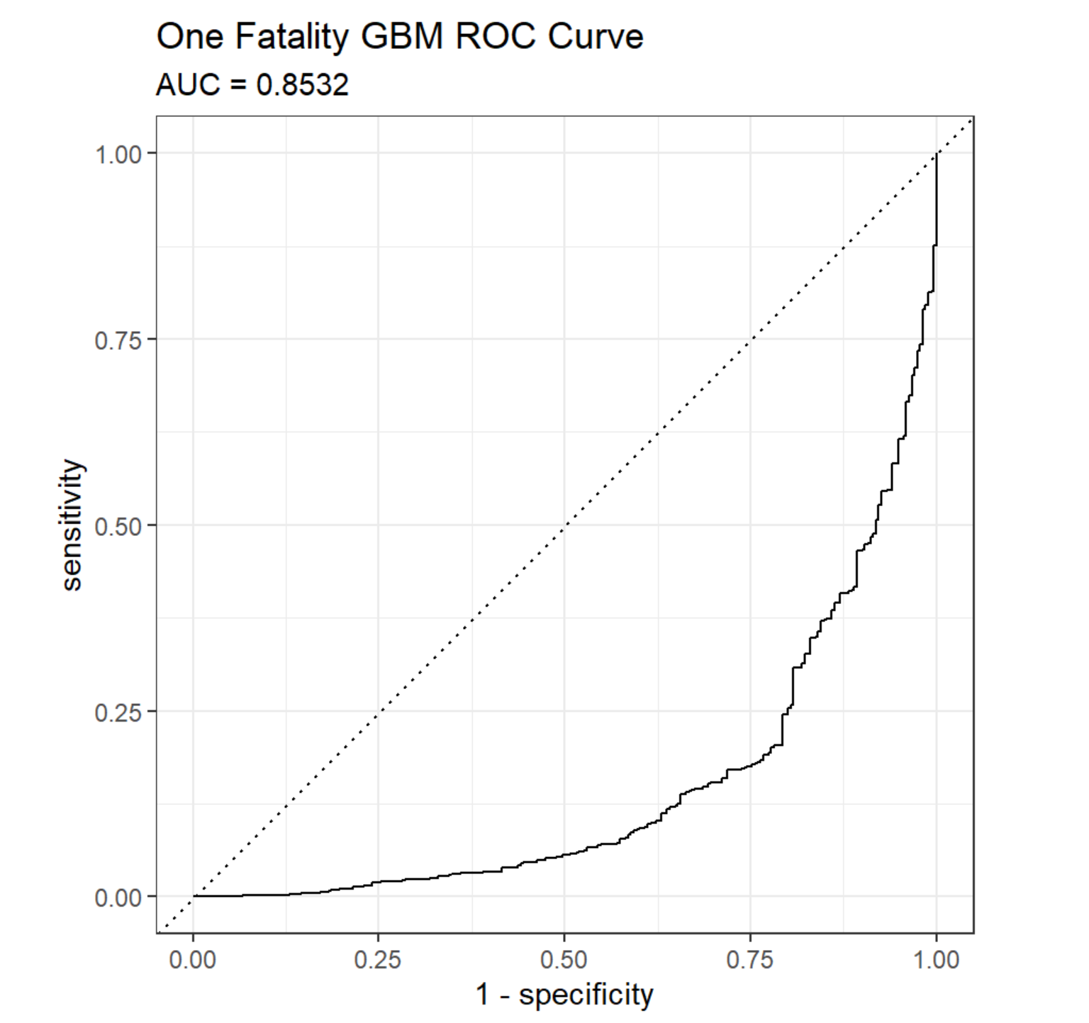
ACLED
Results
Notes:
We wanted to know where conflict was taking place in Ukraine and who the top actors were for those events
So – we built a dashboard using the ACLED dataset to understand where the fatalities and civilian based conflict was occurring, who the key players were and how these events trended over time
So we can look at where the events are taking place
Who was attributable for those events (give example of Russian forces)
Who these actors were interacting with in these events for example NAF was primarily interacting with the Donbass People’s Military, Luhansk and Civilians
How frequently these events were happening
What types of events were taking place – here we can see an greater portion of the events are Explosions/remote violence and battles
Event conflict data helps us analyze events by the type of event, the actors involved in the event or who is accountable, where the event took place and when the event happened and how the frequency of events or trends might have evolved over time.

Slide 8
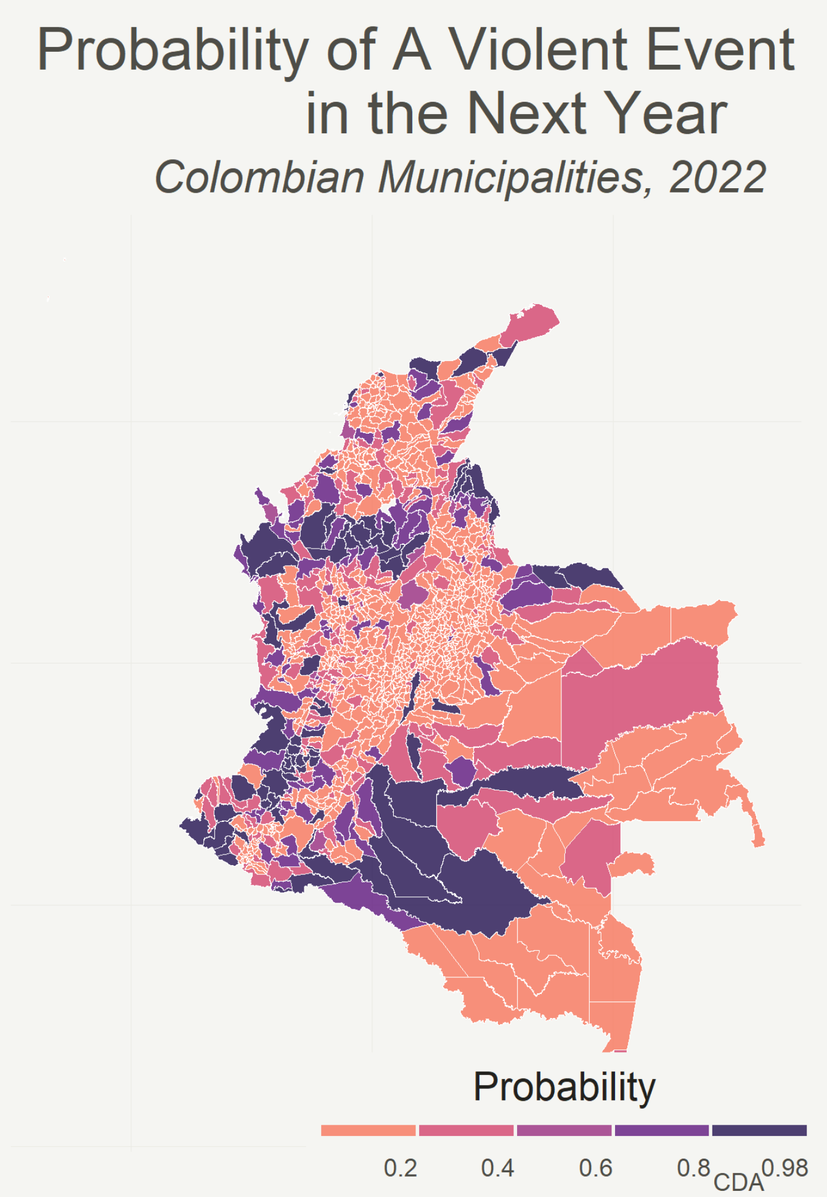
ACLED
Applications
What do we do with all of this?
Example 1a: Mapping out probability of any conflict.
Notes:
We wanted to know where conflict was taking place in Ukraine and who the top actors were for those events
So – we built a dashboard using the ACLED dataset to understand where the fatalities and civilian based conflict was occurring, who the key players were and how these events trended over time
So we can look at where the events are taking place
Who was attributable for those events (give example of Russian forces)
Who these actors were interacting with in these events for example NAF was primarily interacting with the Donbass People’s Military, Luhansk and Civilians
How frequently these events were happening
What types of events were taking place – here we can see an greater portion of the events are Explosions/remote violence and battles
Event conflict data helps us analyze events by the type of event, the actors involved in the event or who is accountable, where the event took place and when the event happened and how the frequency of events or trends might have evolved over time.

Slide 9
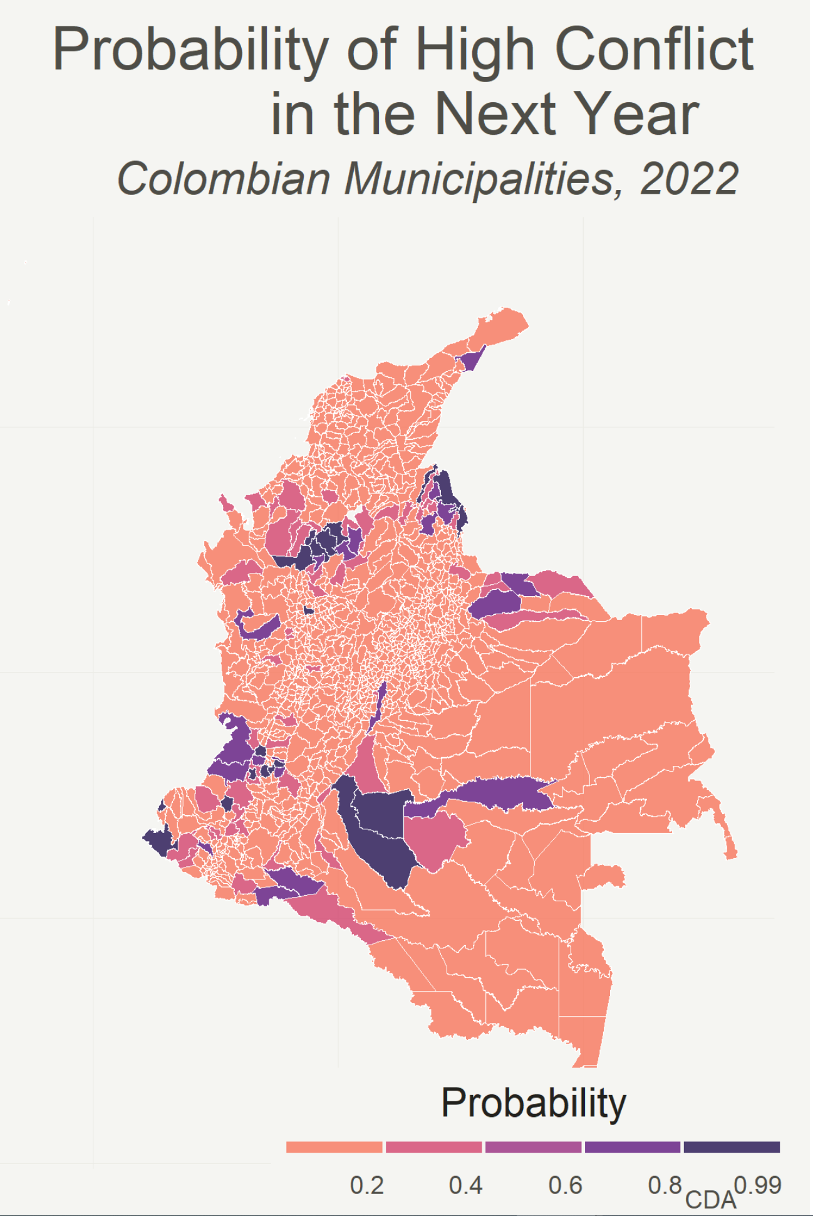
ACLED
Applications
What do we do with all of this?
Example 1b: Mapping out probability of high levels of conflict.
Notes:
We wanted to know where conflict was taking place in Ukraine and who the top actors were for those events
So – we built a dashboard using the ACLED dataset to understand where the fatalities and civilian based conflict was occurring, who the key players were and how these events trended over time
So we can look at where the events are taking place
Who was attributable for those events (give example of Russian forces)
Who these actors were interacting with in these events for example NAF was primarily interacting with the Donbass People’s Military, Luhansk and Civilians
How frequently these events were happening
What types of events were taking place – here we can see an greater portion of the events are Explosions/remote violence and battles
Event conflict data helps us analyze events by the type of event, the actors involved in the event or who is accountable, where the event took place and when the event happened and how the frequency of events or trends might have evolved over time.

Slide 10
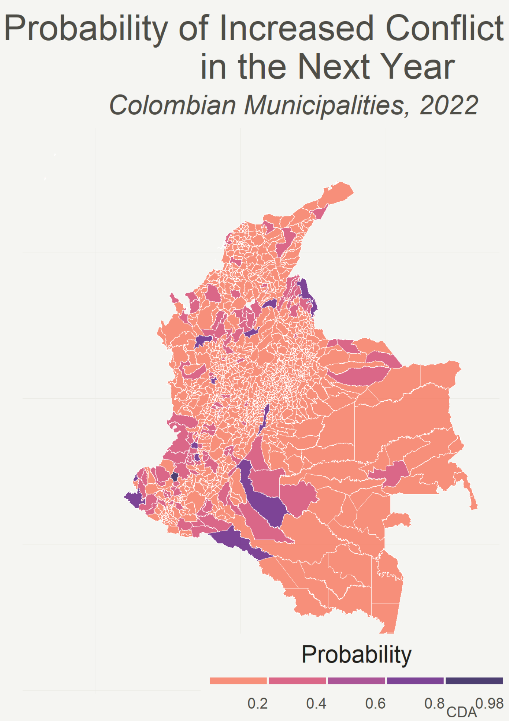
ACLED
Applications
What do we do with all of this?
Example 1c: Mapping out probability of increased conflict
Notes:
We wanted to know where conflict was taking place in Ukraine and who the top actors were for those events
So – we built a dashboard using the ACLED dataset to understand where the fatalities and civilian based conflict was occurring, who the key players were and how these events trended over time
So we can look at where the events are taking place
Who was attributable for those events (give example of Russian forces)
Who these actors were interacting with in these events for example NAF was primarily interacting with the Donbass People’s Military, Luhansk and Civilians
How frequently these events were happening
What types of events were taking place – here we can see an greater portion of the events are Explosions/remote violence and battles
Event conflict data helps us analyze events by the type of event, the actors involved in the event or who is accountable, where the event took place and when the event happened and how the frequency of events or trends might have evolved over time.

Slide 11
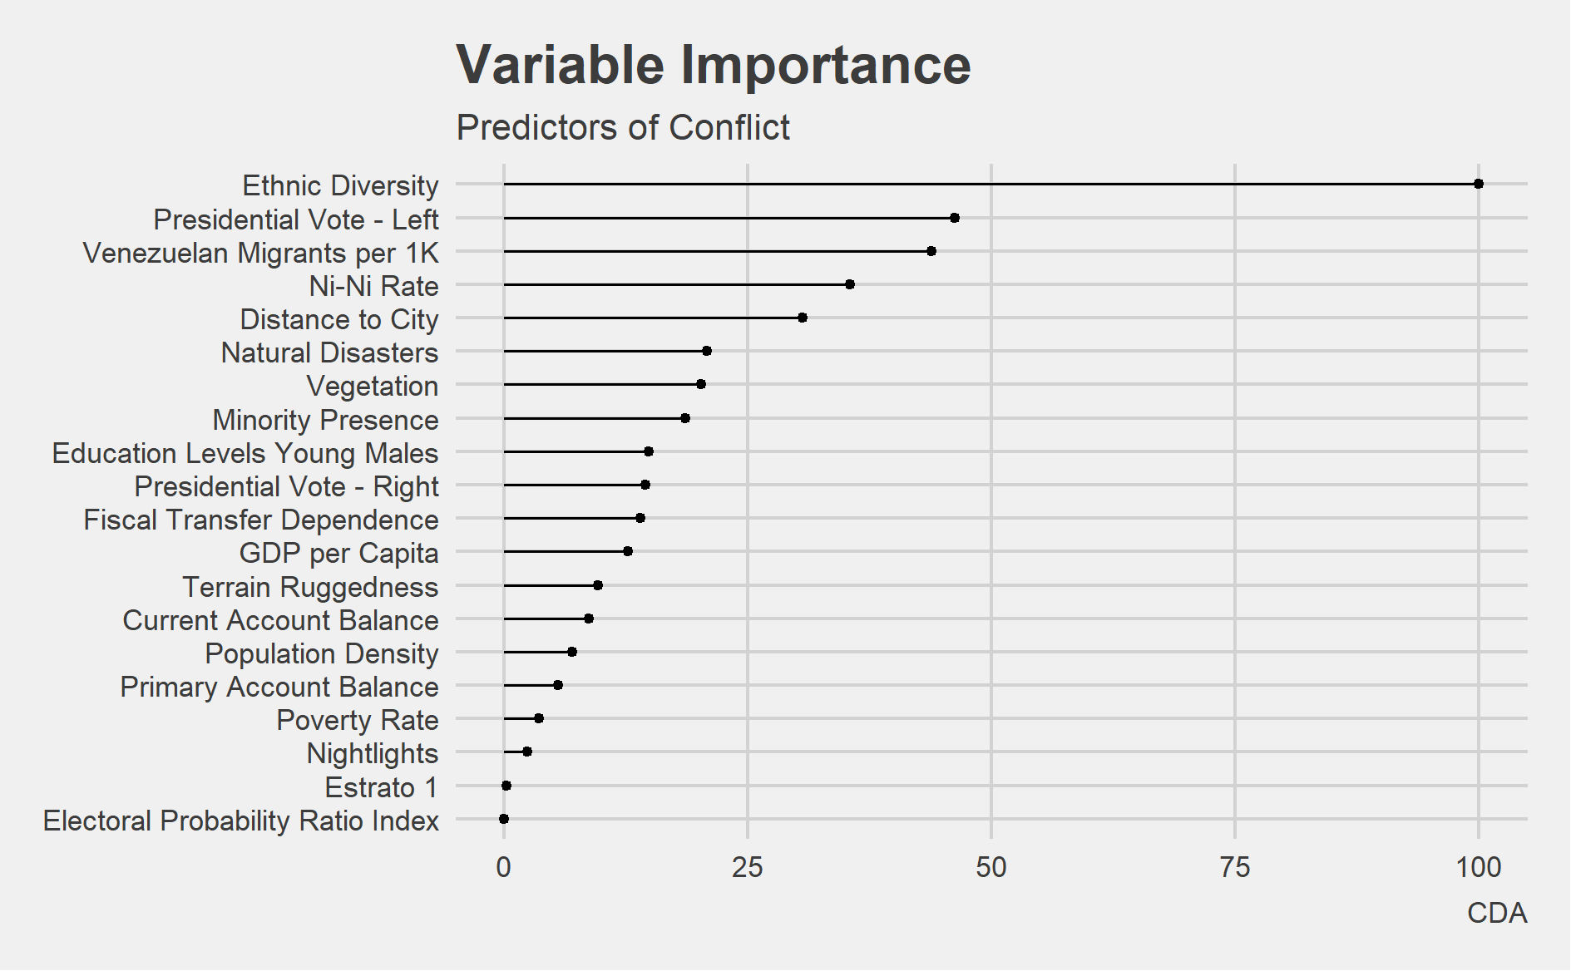
ACLED
Applications
What do we do with all of this?
Example 2: Exploring the drivers of conflict
Notes:
We wanted to know where conflict was taking place in Ukraine and who the top actors were for those events
So – we built a dashboard using the ACLED dataset to understand where the fatalities and civilian based conflict was occurring, who the key players were and how these events trended over time
So we can look at where the events are taking place
Who was attributable for those events (give example of Russian forces)
Who these actors were interacting with in these events for example NAF was primarily interacting with the Donbass People’s Military, Luhansk and Civilians
How frequently these events were happening
What types of events were taking place – here we can see an greater portion of the events are Explosions/remote violence and battles
Event conflict data helps us analyze events by the type of event, the actors involved in the event or who is accountable, where the event took place and when the event happened and how the frequency of events or trends might have evolved over time.

Slide 12
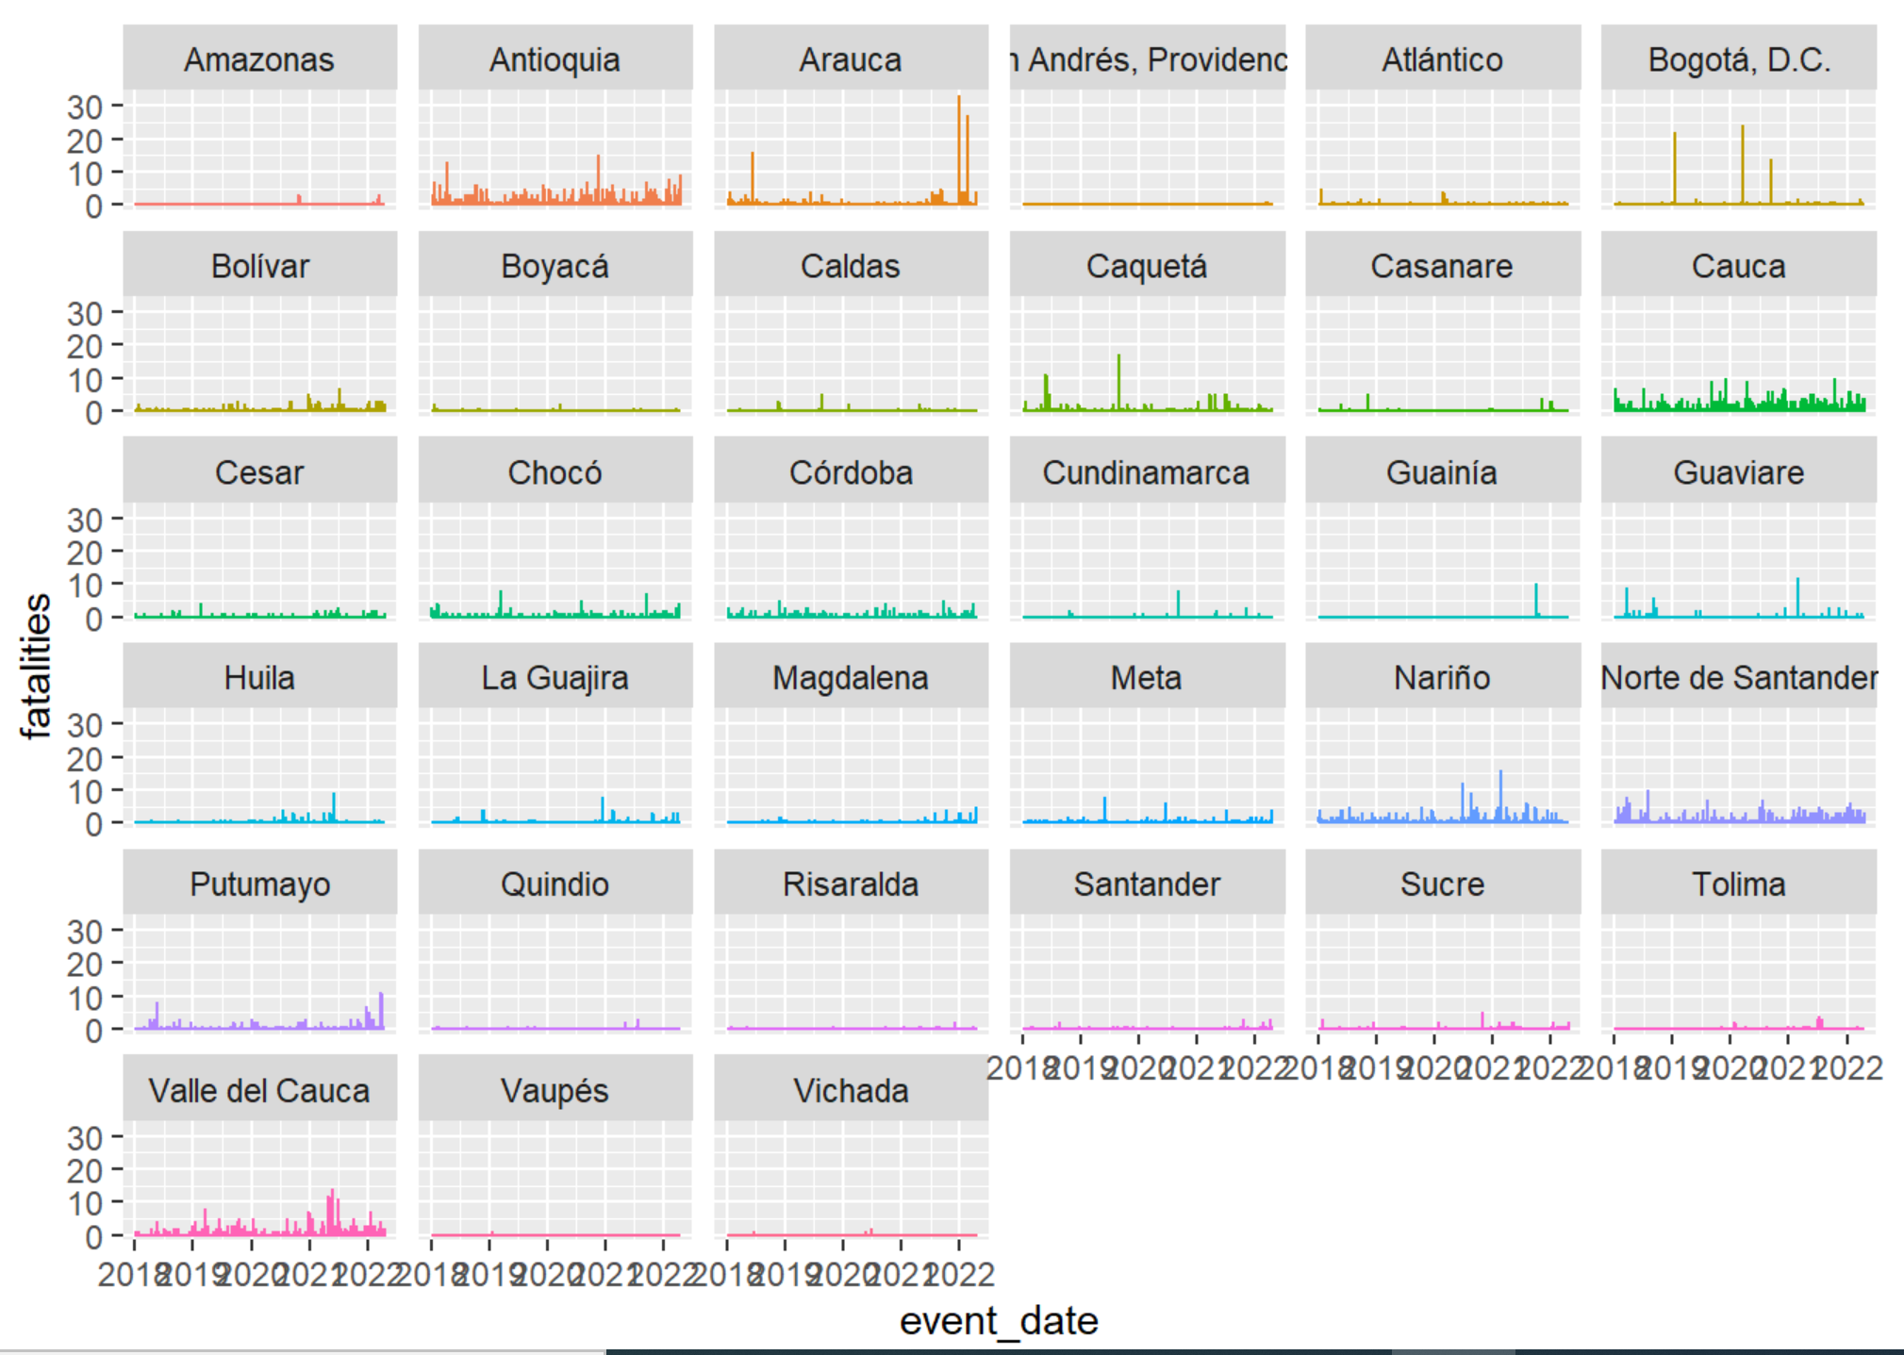
ACLED
Applications
What do we do with all of this?
Example 3: Hierarchical monthly forecasting using ARIMA models.
Notes:
We wanted to know where conflict was taking place in Ukraine and who the top actors were for those events
So – we built a dashboard using the ACLED dataset to understand where the fatalities and civilian based conflict was occurring, who the key players were and how these events trended over time
So we can look at where the events are taking place
Who was attributable for those events (give example of Russian forces)
Who these actors were interacting with in these events for example NAF was primarily interacting with the Donbass People’s Military, Luhansk and Civilians
How frequently these events were happening
What types of events were taking place – here we can see an greater portion of the events are Explosions/remote violence and battles
Event conflict data helps us analyze events by the type of event, the actors involved in the event or who is accountable, where the event took place and when the event happened and how the frequency of events or trends might have evolved over time.

